Slide 1

Proposed Solution:
Ministry/ Organisation Name/Students Innovation:
Indian Council for Cultural Relations (ICCR).
PS Code : RK796
Problem Statement Title :
Online Monitoring and Evaluation System for ICCR’s Regional Offices(ROs)?
Team Name : Team Culture
Team Leader Name : Anujkumar Yadav
College Code : C-58531
Institute Name : Bajaj Institute of Technology, Wardha
Theme Name : Smart Automation
Objectives:
Monitor all activities of ICCR’s Regional Offices
and evaluate their performances on real-time basis.
Look after the interest of foreign students studying in various states of India.
Keep track of Monetary Information spent on students and other establishment expenditure.
Develop mechanism to coordinate with local cultural
and educational organizations and the State Government for carrying out ICCR’s mandate of activities.
A web portal will be developed for Indian Council for Cultural Relations (ICCR Head Quarter) providing a dashboard and options to manage Regional Offices and evaluate their activities based on certain parameters.
ICCR RO’s (Regional Offices) will be provided with a dashboard to schedule/plan activities, upload reports for the activities/events conducted (photos, videos, attendance and feedback), manage students (stipends, claims, HRA etc.), handle their grievances etc. and upload Financial information required for audit of an event etc.
A star rating mechanism is proposed to rate the performance of RO's based on parameters of events conduction, international students feedback for the facilities provided and local participants feedback for the events conducted along with detailed expenditure report.
Facility of generating the monthly activity report based on activities submitted and automatic updation of social media accounts (using social media API's) will be provided to avoid duplication of work for better reach of the activities conducted.
Regional Offices will be able to generate feedback form links for sharing it amongst participants of events conducted to better improve upon the quality of events.
Portal will showcase all upcoming activities of all Regional Offices of ICCR, for publicizing the events amongst the masses and ensure participation from all stakeholders
Web Dashboard for Near Real-time Analytics of events will be provided to ICCR consisting of information like participation, outreach, expenditure information.

Slide 2


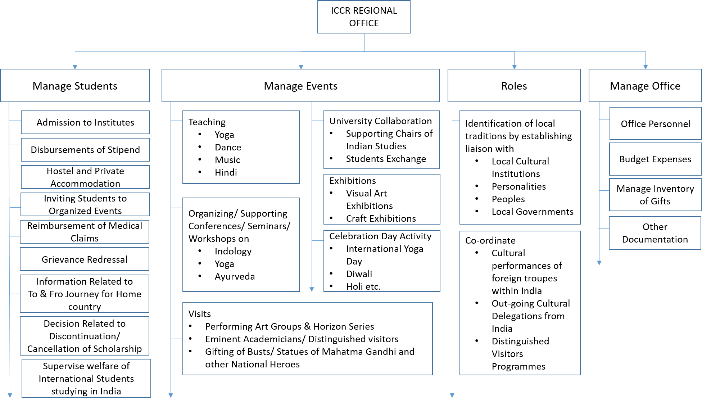





Regional Office Functioning
Modules of Web Portal for
Regional Office
ICCR HQ
Manage Events
Schedule an Event
Invite Participants
Upload Reports
Generate & Share Feedback Link
….
….
Manage Students
Manage Profile
Academic Information
Accommodation Information
Medical Claims Reimbursement
Grievance Redressal System
Feedback Collection
Monetary Information
Fill up Financial Details for
events conduction under various heads
Establishment Expenditure
Co-ordinating Module
(Management Information System )
Figure: Work undertaken by ICCR Regional Offices.
Dependency:
Internet Connectivity
Institutes
Diplomats
Local/ Empanelled Artists
Distinguished Visitors
Stakeholders:
ICCR
Regional Office
Institute
Students

Slide 3
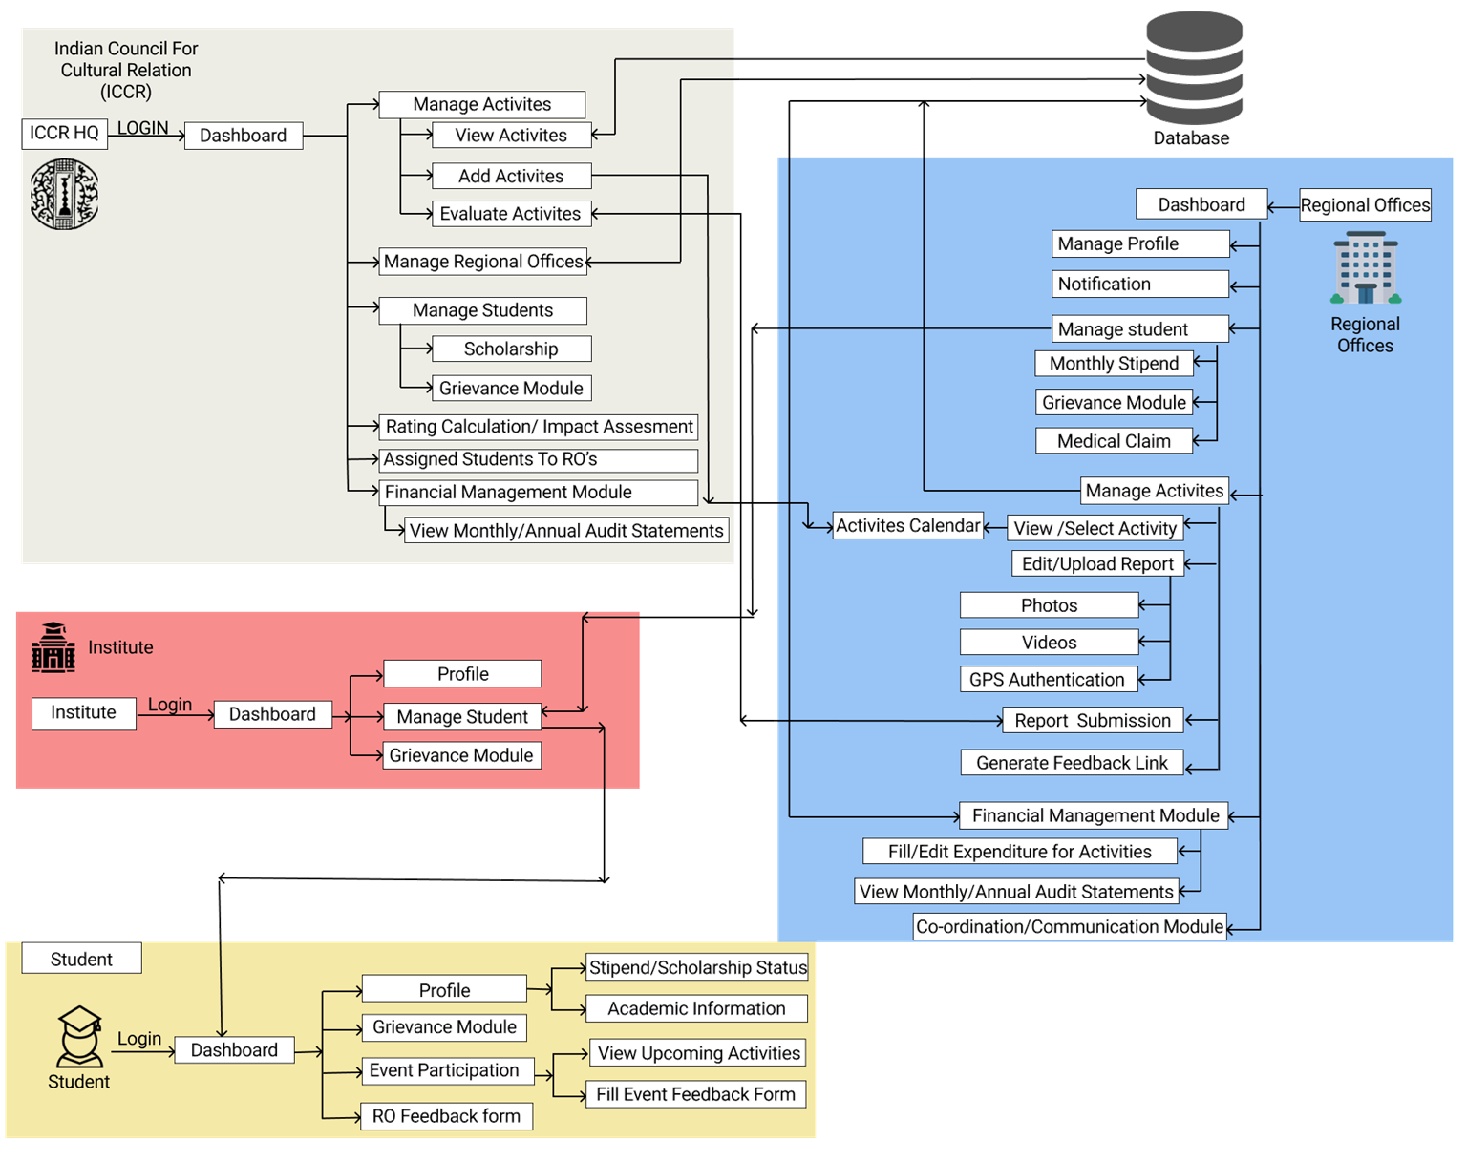
Process Flow
Parameters for
Uploading Reports
List of Documents
The adjoining is the list of documents that are expected to be uploaded for uploading the report of activities.
 | Financial Year
 | Program driven by
 | Quarter I/II/III/IV
 | Event Type & Theme
Duration of activity (in
minutes)
Start Date(In day)/ End Date(In day)
No. of Students Participants
Number of external participants
Upload Bills/
Receipts
Expenditure Amount
Video URL
Attachment
Photographs
Social media URL
Overall report of the activity

Slide 4

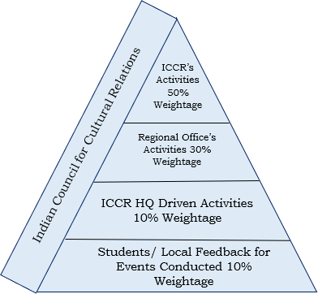
Online Performance and Evaluation System(Proposed)
The ICCR will prescribed an Annual Calendar (Quarter-wise Schedule) of activities for regional office.
To Create the Online Monitoring and Evaluation System for ICCR’s Regional Offices(ROs), the solution proposes to divide the activities in three different types. The activities are classified as
ICCR Annual Calendar Activity: Regional Office have to select minimum number of prescribed activities from annual calendar, conduct them and upload their report.
Self-Driven Activities: Regional Offices are situated in states with diverse cultures, thus regional offices are encouraged to conduct self-driven activities promoting regional culture.
ICCR HQ Driven Activities: The ICCR HQ at national level may also conduct activities different from Annual Calendar, RO’s will participate in those activities and upload its report.
The Regional Offices will upload reports to Centralized System mentioning all the information related to conduction of event along with geo-tagged photos and financial report involved.
The ICCR HQ will be able to view all reports on real- time basis and evaluate the reports, rate the working of Regional Office. ICCR HQ can Approve, Reject or ask RO to Resubmit the report.
Based on Evaluation Regional offices will be allotted 5-star ratings. Parameters for Rating of Regional Office includes:
No. of ICCR Driven Activities Conducted
No. of Self-Driven activities conducted
Feedback Received (International Students)
Feedback Received by Participants for events conducted
Rewards points will be provided for extra activities
conducted more than prescribed limit.
As ICCR regional offices are directly associated with students, hence the students feedback is given due consideration in overall star rating in fifth star.
Parameters for Students Feedback
Scholarship
Stipend Disbursement
Grievance Redressal
Hostel/Private Accommodation
Medical Claim
Support from Regional Office
Table: Rating Points Calculation Mechanism for Regional Offices
Parameters for Calculation of First 4 Stars
Parameters for 5th Star
Total Score
Minimum Activities
Sr.
No.
Effective Score Range for Star allocation from Quarter 1 to Quarter 4
Score Range Star allocation
0<=Score<=25 1
25<Score<=50 2
50<Score<=75 3
75<Score<=100 4
Score range for 5th Star allocation:
Score Range Star allocation
Score<50 0.5
Score=>50 1
Activity Type Weightage in % Q1 Q2 Q3 Q4
ICCR Annual Calendar Plan 50% 12.5 12.5 12.5 12.5 50
Parameter
Weightage
P
Student's Feedback Regarding
1 Services/ Facilities provided by Regional Office
Regional Office Self-Driven Activities
50
30% 7.5 7.5 7.5 7.5 30
10% 2.5 2.5 2.5 2.5 10
10% 2.5 2.5 2.5 2.5 10
100% 25 25 25 25 100
Q
All Activities
Mandatory
2 Reward Points Earned
20
ICCR HQ Driven Activities
3
Contribution in Monthly & Annual
Magazines of ICCR
15
Students/ Local Feedback for Events Conducted
-
4
Submission of Annual Report of Regional Office
15
Total Score
P + Q
Total
100

Slide 5
Online Performance and Evaluation System(Proposed)
The ICCR HQ will be able to view all reports on real- time basis and evaluate the reports, rate the working of Regional Office. ICCR HQ can Approve, Reject or ask RO to Resubmit the report.
Based on Evaluation Regional offices will be allotted 5-star ratings. Parameters for Rating of Regional Office includes:
No. of ICCR Driven Activities Conducted
No. of Self-Driven activities conducted
Feedback Received (International Students)
Feedback Received by Participants for events conducted
Rewards points will be provided for extra activities
conducted more than prescribed limit.
As ICCR regional offices are directly associated with students, hence the students feedback is given due consideration in overall star rating in fifth star.
Parameters for Students Feedback
Scholarship
Stipend Disbursement
Grievance Redressal
Hostel/Private Accommodation
Medical Claim
Support from Regional Office
Table: Rating Points Calculation Mechanism for Regional Offices
Parameters for Calculation of First 4 Stars
Parameters for 5th Star
Total Score
Minimum Activities
Sr.
No.
Effective Score Range for Star allocation from Quarter 1 to Quarter 4
Score Range Star allocation
0<=Score<=25 1
25<Score<=50 2
50<Score<=75 3
75<Score<=100 4
Score range for 5th Star allocation:
Score Range Star allocation
Score<50 0.5
Score=>50 1
Activity Type Weightage in % Q1 Q2 Q3 Q4
ICCR Annual Calendar Plan 50% 12.5 12.5 12.5 12.5 50
Parameter
Weightage
P
Student's Feedback Regarding
1 Services/ Facilities provided by Regional Office
Regional Office Self-Driven Activities
50
30% 7.5 7.5 7.5 7.5 30
10% 2.5 2.5 2.5 2.5 10
10% 2.5 2.5 2.5 2.5 10
100% 25 25 25 25 100
Q
All Activities
Mandatory
2 Reward Points Earned
20
ICCR HQ Driven Activities
3
Contribution in Monthly & Annual
Magazines of ICCR
15
Students/ Local Feedback for Events Conducted
-
4
Submission of Annual Report of Regional Office
15
Total Score
P + Q
Total
100

Slide 6
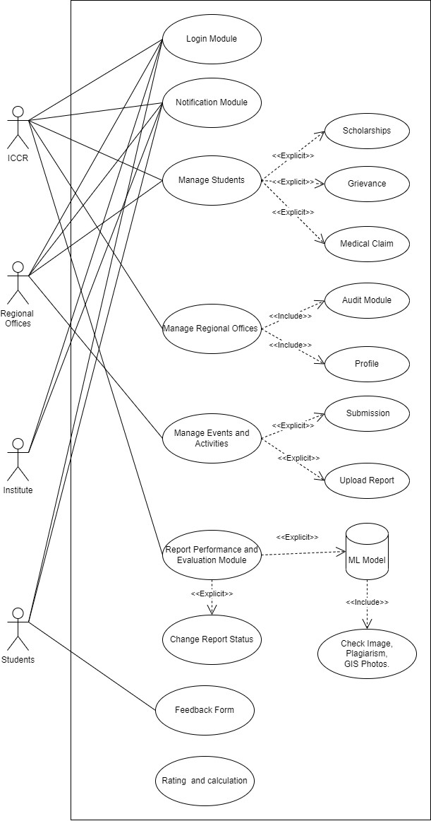
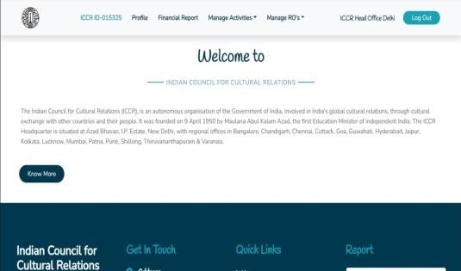

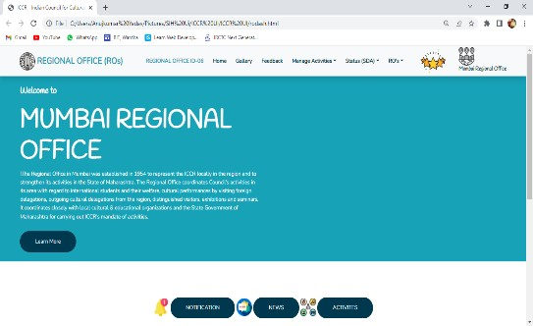
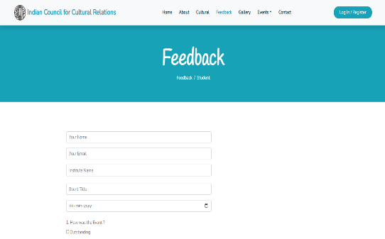
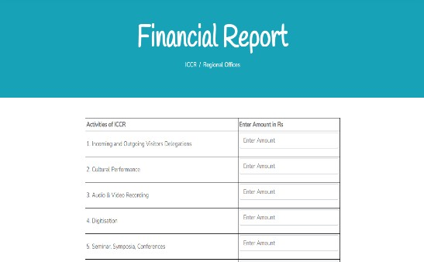







Use-Case Diagram
Snapshots
Team Information
ICCR Dashboard | ICCR Home Page
RO’s Dashboard | Students Feedback
ICCR Finance Report | Technology Stack
Team Leader Name: Anujkumar Yadav Branch: B.Tech
Stream: Computer Engineering Year II:
Team Member 1 Name : Prem Mungle
Branch: B.Tech
Stream: Computer Engineering Year II:
Team Member 2 Name : Harsh Kushwaha Branch: B.Tech
Stream: Computer Engineering
Year II:
Team Member 3 Name : Aditya Jha Branch: B.Tech
Stream: Computer Engineering Year II:
Team Member 4 Name : Neha Chopade Branch: B.Tech
Stream: Computer Engineering Year II:
Team Member 5 Name : Vaishnavi Jayade Branch: B.Tech
Stream: Computer Engineering
Year II:
Team Mentor 1 Name: Prof. Sandesh Jain Category: Academic
Expertise: Full Stack Development, Blockchain Domain Experience (in years): 7 Years
Conclusion:
Thus, this website will help ICCR to monitor activities performed by regional offices and help them rate their performance. The website will also help generate Monthly & Annual Activity & Financial Reports. The feedback received from International students will help ICCR devise better student friendly policies, thus improving students participation in cultural activities.
Team Mentor 2 Name: Mr. Amol Jumde Category: Academic
Expertise: Machine Learning
Domain Experience (in years): 4 Years

